Slide 1

Pair Programming
Sudeep Lal Bajimaya

Slide 2



Slide 3

What do we see?
Two person working on the same task
One is executing the task
Another is navigating (watches for external factors, evaluates the situation, corrects him and validates success after execution)
Two different expertise
Working as team

Slide 4
What is pair programming
Pair programming consists of two programmers sharing a single workstation ( one screen, keyboard and mouse among the pair).
The programmer at the keyboard is usually called the –driver
The other, also actively involved in the programming task but focusing more on overall direction is the -navigator
It is expected that the programmers swap roles every few minutes or so.

Slide 5
Key Principles
Communication
Learning
Knowledge sharing

Slide 6
Guidelines
Share everything
Play fair
Don’t hit people
Put things back where you found them
Clean up you own mess
Don’t take things aren’t yours
Trust each other

Slide 7
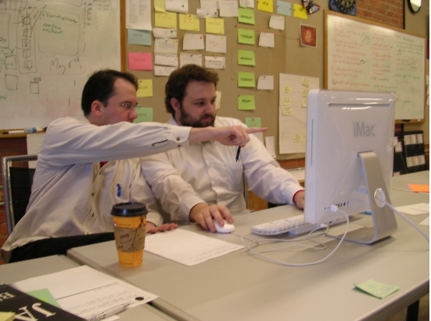
Perfect setup for pair

Slide 8
Potential costs
A quiet navigator will create a dysfunctional pair. Both programmers must be able to maintain a steady conversation.
An initial decline in productivity is sometimes observed when engineers start to pair program.
Noise from a pair can disturb others who work alone.
There can be a conflict of egos or personality depending on the programmers involved. This could result in uncomfortable feelings and reduce productivity, negating the potential benefits of pair programming.
Everyone has to want to pair. Some programmers are very intrinsic and have a deep sense of personal ownership about the code they write, these feelings can be difficult to overcome at first.

Slide 9
Software engineers are conditioned to work alone. It may feel like they are wasting their time with slower programmers or they may feel inadequate compared to their peers. Attempting pair programming with these types of feelings can lead to a loss in the benefits offered by the practice.
Pairing an inexperienced programmer with someone more competent can result in feelings of intimidation, resulting in less participation between the two.
Economics: organizations can be concerned that pair programming will double the development costs as two programmers on working on one task. The result is that it can be difficult to convince management to come onboard with the practice.
Coordination can be a challenge as the team must decide who works with whom every day. Also, the team needs to decide which portions of the day should be paired sessions during which no meetings would take place.

Slide 10
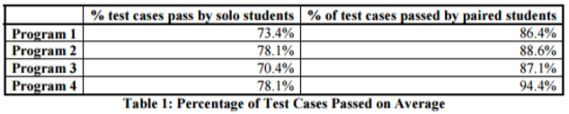
Expected Benefits
improved product quality: pairs produce shorter programs than solo peers, indicating superior designs.
Programs written by paired developers pass more test cases than those written by solo programmers

Slide 11
PRINCIPLES OF PAIR PROGRAMMING
Pair Pressure
Pair Negotiation and Brainstorming
Pair Courage
Pair Reviews
Pair Debugging
Pair Learning and Training

Slide 12
Challenges of pair programming
Bias/Habit
Economics
Coordination
Distributed teams

Slide 13


Slide 14
Reference and bibliography
https://pdfs.semanticscholar.org/1d4c/7da6969ad0df86aa1d81274305fddc1e20e0.pdf
M. Mizanur Rahman, CSD 2018.
E. Arisholm, H. Gallis, T. Dybå, and D. Sjøberg, "Evaluating Pair Programming with Respect to System Complexity and Programmer Expertise," IEEE Transacations in Software Engineering, vol. 33, no. 2, pp. 65-86, February 2007.
B. Hanks, "Problems Encountered by Novice Pair Programmers," in International Computing Education Research Workshop, Atlanta, GA, 2007, pp. 159 - 164.

